Slide 1
CAP-791

Slide 2
How User Authentication is Done
Authentication is the process of verifying the identity of users or information.
User authentication is the process of verifying the identity of the user when that user logs in to a computer system.
The main objective of authentication is to allow authorized users to access the computer and to deny access to unauthorized users.

Slide 3
Authentication in cybersecurity
Authentication is important because it enables organizations to keep their networks secure by permitting only authenticated users (or processes) to access its protected resources, which may include computer systems, networks, databases, websites and other network-based applications or services.

Slide 4
Continue..
Once authenticated, a user or process is usually subjected to an authorization process as well, to determine whether the authenticated entity should be permitted access to a protected resource or system.
A user can be authenticated but fail to be given access to a resource if that user was not granted permission to access it.

Slide 5
How authentication is used
User authentication occurs within most human-to-computer interactions outside of guest accounts, automatically logged-in accounts and kiosk computer systems.
Generally, a user has to choose a username or user ID and provide a valid password to begin using a system.
User authentication authorizes human-to-machine interactions in operating systems and applications, as well as both wired and wireless networks to enable access to networked and internet-connected systems, applications and resources.

Slide 6
Continue..
Organizations also use authentication to control which users have access to corporate networks and resources, as well as to identify and control which machines and servers have access. Companies also use authentication to enable remote employees to securely access their applications and networks.
For enterprises and other large organizations, authentication may be accomplished using a single sign-on (SSO) system, which grants access to multiple systems with a single set of login credentials.

Slide 7
Challenge
Take username and password as string input from the user.
Check if the username matches the password or not.
If it matches then welcome the user.
Else display an appropriate message.

Slide 8
CLASSICAL ENCRYPTION TECHNIQUES
There are two basic building blocks of all encryption techniques:
substitution and transposition.

Slide 9
1 SUBSTITUTION TECHNIQUES
A substitution technique is one in which the letters of plaintext are replaced by other letters or by numbers or symbols.
If the plaintext is viewed as a sequence of bits, then substitution involves replacing plaintext bit patterns with cipher text bit patterns.

Slide 10
(i)Caesar cipher (or) shift cipher
The earliest known use of a substitution cipher and the simplest was by Julius Caesar. The Caesar cipher involves replacing each letter of the alphabet with the letter standing 3 places further down the alphabet.
e.g., Plain text : pay more mone Cipher text: SDB PRUH PRQHB
Note that the alphabet is wrapped around, so that letter following „z‟ is „a‟. For each plaintext letter p, substitute the cipher text letter c such that C =
E(p) = (p+3) mod 26
A shift may be any amount, so that general Caesar algorithm is C = E (p) = (p+k) mod 26
Where k takes on a value in the range 1 to 25. The decryption algorithm is simply P = D(C) = (C-k) mod 26

Slide 11
(ii) playfair cipher
The best known multiple letter encryption cipher is the playfair, which treats digrams in the plaintext as single units and translates these units into cipher text digrams.
The playfair algorithm is based on the use of 5x5 matrix of letters constructed using a keyword.
Let the keyword be „monarchy‟. The matrix is constructed by filling in the letters of the keyword (minus duplicates) from left to right and from top to bottom, and then filling in the remainder of the matrix with the remaining letters in alphabetical order.

Slide 12
Continue..
The letter „i‟ and „j‟ count as one letter. Plaintext is encrypted two letters at a time according to the following rules:
Repeating plaintext letters that would fall in the same pair are separated with a filler letter such as „x‟.
Plaintext letters that fall in the same row of the matrix are each replaced by the letter to the right, with the first element of the row following the last.
Plaintext letters that fall in the same column are replaced by the letter beneath, with the top element of the column following the last.
Otherwise, each plaintext letter is replaced by the letter that lies in its own row and the column occupied by the other plaintext letter.

Slide 13
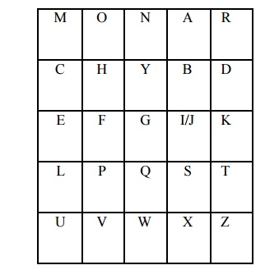
Continue..

Slide 14
(iii)Polyalphabetic ciphers
Another way to improve on the simple monoalphabetic technique is to use different monoalphabetic substitutions as one proceeds through the plaintext message. The general name for this approach is polyalphabetic cipher. All the techniques have the following features in common.
A set of related monoalphabetic substitution rules are used
A key determines which particular rule is chosen for a given transformation.

Slide 15
(iv)Vigenere cipher
In this scheme, the set of related monoalphabetic substitution rules consisting of 26 caesar ciphers with shifts of 0 through 25. Each cipher is denoted by a key letter. e.g.,
Caesar cipher with a shift of 3 is denoted by the key value 'd‟ (since a=0, b=1, c=2 and so on). To aid in understanding the scheme, a matrix known as vigenere tableau is constructed.

Slide 16
Continue..
Each of the 26 ciphers is laid out horizontally, with the key letter for each cipher to its left. A normal alphabet for the plaintext runs across the top.
The process of encryption is simple: Given a key letter X and a plaintext letter y, the cipher text is at the intersection of the row labeled x and the column labeled y; in this case, the ciphertext is V.

Slide 17
Continue..
To encrypt a message, a key is needed that is as long as the message. Usually, the key is a repeating keyword.
e.g., key = d e c e p t i v e d e c e p t i v e d e c e p t i v e
PT =
w e a r e d i s c o v e r e d s a v e y o u r s e l f
CT = ZICVTWQNGRZGVTWAVZHCQYGLMGJ

Slide 18
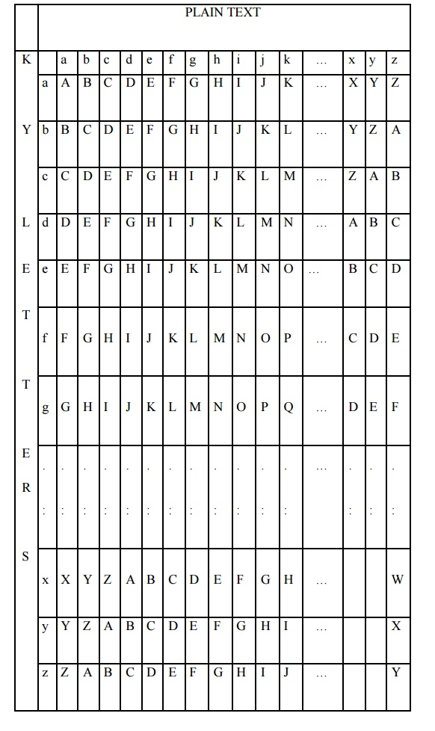
Continue..

Slide 19
2 TRANSPOSITION TECHNIQUES
All the techniques examined so far involve the substitution of a cipher text symbol for a plaintext symbol. A very different kind of mapping is achieved by performing some sort of permutation on the plaintext letters. This technique is referred to as a transposition cipher.

Slide 20
Rail Fence Cipher
Given a plain-text message and a numeric key, cipher/de-cipher the given text using Rail Fence algorithm.
The rail fence cipher (also called a zigzag cipher) is a form of transposition cipher. It derives its name from the way in which it is encoded.

Slide 21
Rail fence
Rail fence is simplest of such cipher, in which the plaintext is written down as a sequence of diagonals and then read off as a sequence of rows.
Plaintext = meet at the school house
To encipher this message with a rail fence of depth 2, we write the message as follows:
m e a t e c o l o s
e t t h s H o h u e
The encrypted message is:
MEATECOLOSETTHSHOHUE

Slide 22
Encryption
In a transposition cipher, the order of the alphabets is re-arranged to obtain the cipher-text.
In the rail fence cipher, the plain-text is written downwards and diagonally on successive rails of an imaginary fence.
When we reach the bottom rail, we traverse upwards moving diagonally, after reaching the top rail, the direction is changed again. Thus the alphabets of the message are written in a zig-zag manner.
After each alphabet has been written, the individual rows are combined to obtain the cipher-text.

Slide 23
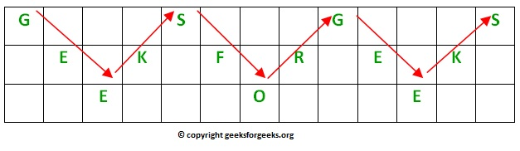
For example, if the message is “GeeksforGeeks” and the number of rails = 3 then cipher is prepared as:

Slide 24
Decryption
As we’ve seen earlier, the number of columns in rail fence cipher remains equal to the length of plain-text message. And the key corresponds to the number of rails.
Hence, rail matrix can be constructed accordingly. Once we’ve got the matrix we can figure-out the spots where texts should be placed (using the same way of moving diagonally up and down alternatively ).
Then, we fill the cipher-text row wise. After filling it, we traverse the matrix in zig-zag manner to obtain the original text.

Slide 25
Implementation:
Let cipher-text = “GsGsekfrek eoe” , and Key = 3
Number of columns in matrix = len(cipher-text) = 13
Number of rows = key = 3
Hence original matrix will be of 3*13 .

Slide 26
Example 1
Encryption
Input : "GeeksforGeeks "
Key = 3
Output : GsGsekfrek eoe
Decryption
Input : GsGsekfrek eoe
Key = 3
Output : "GeeksforGeeks "

Slide 27
Example 2
Encryption
Input : "defend the east wall"
Key = 3
Output : dnhaweedtees alf tl
Decryption
Input : dnhaweedtees alf tl
Key = 3
Output : defend the east wall

Slide 28
Example 3
Encryption
Input : "attack at once"
Key = 2
Output : atc toctaka ne
Decryption
Input : "atc toctaka ne"
Key = 2
Output : attack at once

Slide 29
Row Transposition Ciphers
Row Transposition Ciphers-A more complex scheme is to write the message in a rectangle, row by row, and read the message off, column by column, but permute the order of the columns. The order of columns then becomes the key of the algorithm.
e.g., plaintext = meet at the school house

Slide 30
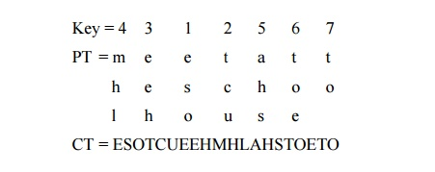
Continue..

Slide 31
Continue..
A pure transposition cipher is easily recognized because it has the same letter frequencies as the original plaintext. The transposition cipher can be made significantly more secure by performing more than one stage of transposition. The result is more complex permutation that is not easily reconstructed.

Slide 32
An example of asymmetric cryptography :
A client (for example browser) sends its public key to the server and requests for some data.
The server encrypts the data using client’s public key and sends the encrypted data.
Client receives this data and decrypts it.

Slide 33
Continue..
The idea! The idea of RSA is based on the fact that it is difficult to factorize a large integer.
The public key consists of two numbers where one number is multiplication of two large prime numbers.
And private key is also derived from the same two prime numbers. So if somebody can factorize the large number, the private key is compromised.

Slide 34
Continue..
Therefore encryption strength totally lies on the key size and if we double or triple the key size, the strength of encryption increases exponentially.
RSA keys can be typically 1024 or 2048 bits long, but experts believe that 1024 bit keys could be broken in the near future. But till now it seems to be an infeasible task.

Slide 35
RSA Algorithm in Cryptography
RSA algorithm is asymmetric cryptography algorithm. Asymmetric actually means that it works on two different keys i.e. Public Key and Private Key. As the name describes that the Public Key is given to everyone and Private key is kept private.

Slide 36
Continue..
Encryption using RSA:
To encrypt a plaintext M using an RSA public key we simply represent the plaintext as a number between 0 and N-1 and then compute the ciphertext C as:
C = Me mod N.
Decryption using RSA:
To decrypt a ciphertext C using an RSA public key we simply compute the plaintext M as:
M = Cd mod N.

Slide 37
Continue..
Note that both RSA encryption and RSA decryption involve a modular exponentiation and so we would be well advised to use the Repeated Squares Algorithm if we want to make these processes reasonably efficient.

Slide 38
RSA(Rivest-Shamir-Adleman)
RSA(Rivest-Shamir-Adleman) is an Asymmetric encryption technique that uses two different keys as public and private keys to perform the encryption and decryption.
With RSA, you can encrypt sensitive information with a public key and a matching private key is used to decrypt the encrypted message.
Asymmetric encryption is mostly used when there are 2 different endpoints are involved such as VPN client and server, SSH, etc.

Slide 39
Continue..
First, we require public and private keys for RSA encryption and decryption. Hence, below is the tool to generate RSA key online. It generates RSA public key as well as the private key of size 512 bit, 1024 bit, 2048 bit, 3072 bit and 4096 bit with Base64 encoded.
By default, the private key is generated in PKCS#8 format and the public key is generated in X.509 format.

Slide 40
Generating Public Key :
Select two prime no's. Suppose P = 53 and Q = 59.
Now First part of the Public key : n = P*Q = 3127.
We also need a small exponent say e :
But e Must be
An integer.
Not be a factor of n.
1 < e < Φ(n) [Φ(n) is discussed below],
Let us now consider it to be equal to 3.
Our Public Key is made of n and e

Slide 41
Generating Private Key :
We need to calculate Φ(n) :
Such that Φ(n) = (P-1)(Q-1)
so, Φ(n) = 3016
Now calculate Private Key, d :
d = (k*Φ(n) + 1) / e for some integer k
For k = 2, value of d is 2011.

Slide 42
Continue..
Now we are ready with our – Public Key ( n = 3127 and e = 3) and Private Key(d = 2011)
Now we will encrypt “HI” :
Convert letters to numbers : H = 8 and I = 9
Thus Encrypted Data c = 89e mod n.
Thus our Encrypted Data comes out to be 1394
Now we will decrypt 1394 :
Decrypted Data = cd mod n.
Thus our Encrypted Data comes out to be 89
8 = H and I = 9 i.e. "HI".

Slide 43
Access Control
This includes having permissions to do any of the following to protected items (digital or physical resources):
Access,
Read,
Modify,
Communicate,
Delete or otherwise destroy.

Slide 44
Types of Access Control Systems
Access control systems can be logical or physical in nature and fall within three sub-categories:
Technical control systems,
Administrative control systems, and
Physical control systems.

Slide 45
Examples of virtual and physical access control systems
Login credentials (such as usernames and passwords).
PINs and one-time passwords (OTPs).
Virtual private network (VPN) access to internal networks.
Physical access cards, FOBs, tokens, locks, and keys.
Security guards with access lists.
Biometric readers (such as for facial, retinal, and fingerprint scans).
Digital authentication certificates and digital keys.

Slide 46
Access Control Lists
An access control list, much like the name would imply, is a list of privileges or permissions that authorize or deny access for specific people or groups to specific objects. ACLs consist of various access control entries (ACEs), which specify the subject and any privileges they have for specific objects.
ACLs serve different functions in terms of how and where they’re used and are central to several different access control models. Few quick examples of common access control lists:
Filesystem Access Control Lists,
Active Directory Access Control Lists, and
Network Access Control Lists.

Slide 47
How Access Controls Come Into Play Within Your Organization
When talking about access controls, they can be implemented done through multiple avenues.
Let’s consider a few examples of access control that your organization might already be using.

Slide 48
File-Sharing Platforms like SharePoint and Google Docs
If you use these types of file-sharing platforms, then you’re already familiar with this type of access control.
Whenever you create or share a document, you can choose to either keep control to yourself or give permissions to view or modify the document as a viewer, commenter, or editor.

Slide 49

Continue..

Slide 50
Windows Active Directory
We’ll use Windows Active Directory as our next example. You can set up folder permissions for groups and individuals in Active Directory.
These permissions can be set for specific objects or groups of objects.

Slide 51
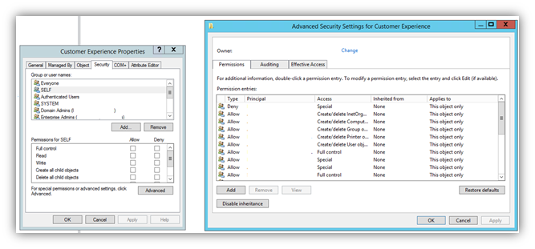
Continue..

Slide 52
Linux Access Controls
You also can use access controls for filesystems. This process involves the use of Linux ACLs to grant permissions to one of three options: users, groups, or others.
The level of access that each of these permission categories could have includes read, write, and execute.

Slide 53
WordPress Access Controls
In WordPress, you also have the option of implementing access control. Think of the different access control settings in WordPress.
You may give a few users Administrator access, which allows them to give other users access, whereas you may only give some editors author access.

Slide 54
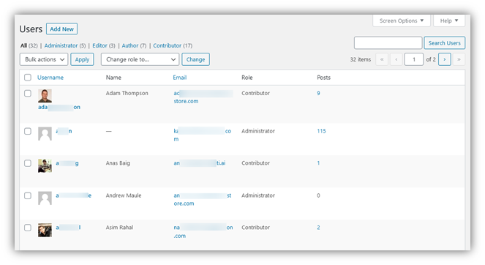
Continue..

Slide 55
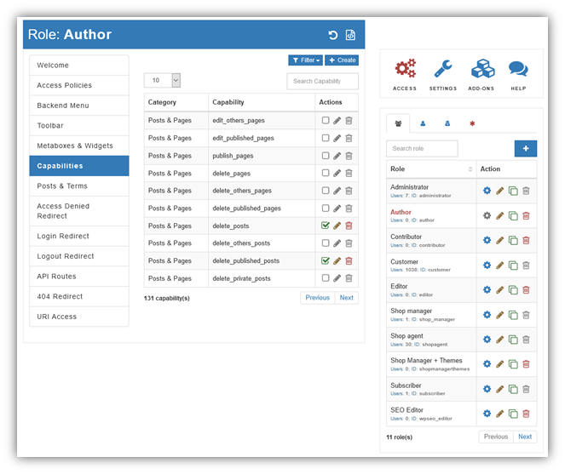
WordPress plugins: Advanced Access Manager (AAM)

Slide 56
Intrusion Detection Software
Safeguarding the security of your IT infrastructure is no easy task.
There are so many components to protect, and no firewall is entirely fool proof. Cyberattacks are constantly evolving, with the express intention of breaching your defenses and compromising your systems, and more come to light every day.
Keeping pace with these developments requires your security solution to be adaptable and comprehensive.

Slide 57
Continue..
An intrusion detection system (IDS) is a vital element of a truly successful solution.
It flags up inbound and outbound malicious traffic, so you can take proactive steps to safeguard your network.
An effective IDS keeps your IT personnel informed, so they can respond rapidly and with precision to a potential threat.

Slide 58
Fact Check:
According to a recently published report by Global Market Insights Inc., the Intrusion Detection/ Prevention system market is expected to grow from US$3 billion in 2018 to US$8 billion by 2025.
The key factors driving the growth of the Intrusion Detection/Prevention system market are unethical practices that occur both internally and externally, and the massive increase in cyberattacks.

Slide 59
Continue..
In addition to the above, the GMI report also reveals that network-based IDS accounts for more than 20% of the share in the global intrusion detection/prevention system market.
Furthermore, the Intrusion Detection System market study by Future Market Insights (FMI) says that the global IDS market is segmented based on type, services, and deployment model.

Slide 60
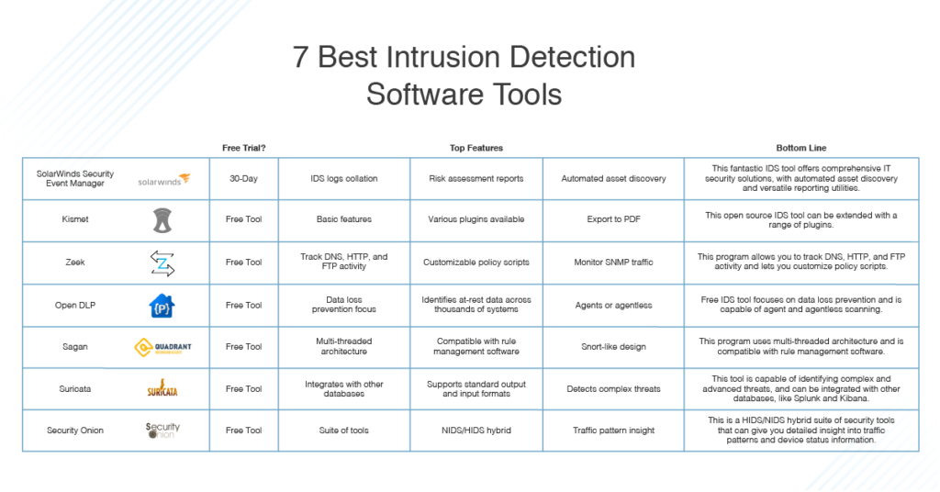

Slide 61
What Is an Intrusion Detection System (IDS)?
An intrusion detection system, IDS for short, monitors network and system traffic for any suspicious activity.
Once any potential threats have been identified, intrusion detection software sends notifications to alert you to them.
The latest IDS software will proactively analyze and identify patterns indicative of a range of cyberattack types.
An effective solution should be able to discover any threats before they fully infiltrate the system.

Slide 62
Continue..
While this is the basic function and purpose of intrusion detection software, not all programs are created equal.
Some let you implement rules, which the program then uses to inform and execute certain actions and tasks, while others do not.
Open-source IDS options are also available, which can differ significantly from closed source software, so it’s important to understand the nuances of an open-source network intrusion detection system before choosing it.

Slide 63
Continue..
The latest IDS software programs are likely to include specialist and advanced features, so it’s worth considering how useful these more sophisticated components would be to your business.
After all, it may not be cost-effective for an organization with minimal network intrusion detection requirements to choose the most advanced and latest IDS software.

Slide 64
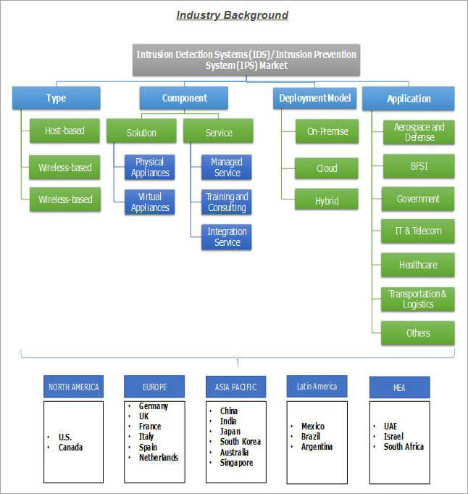

Slide 65
Types of IDS
An intrusion detection system comes in one of two types: a host-based intrusion detection system (HIDS) or a network-based intrusion detection system (NIDS).
To put it simply, a HIDS system examines the events on a computer connected to your network, instead of examining traffic passing through the system.
As its name suggests, it’s based around the host. A NIDS, on the other hand, examines the network traffic.

Slide 66
Network-Based Intrusion Detection System (NIDS)
As a system that examines and analyzes network traffic, a network-based intrusion detection system must feature a packet sniffer, which gathers network traffic, as standard.
Though NIDSs can vary, they typically include a rule-based analysis engine, which can be customized with your own rules.
In some cases, NIDSs have a user community producing rules you can import directly, to save you time.
It may take some time to get familiar with the rule syntax of your chosen NIDS and being able to import from the user community can make the initial NIDS implementation feel like less of a steep learning curve.

Slide 67
Host-Based Intrusion Detection System (HIDS)
Instead of examining the traffic, host-based intrusion detection systems examine the events on a computer connected to your network, by looking into admin file data.
This usually includes configuration and log files. A HIDS will back up your configuration files, so you can restore previous settings if a virus affects system security by altering the device setup.
You’ll also want to defend yourself against root access on Unix-like platforms or Windows system registry changes.
A HIDS can’t block these alterations, but it should notify you so you can act to rectify or prevent them.

Slide 68
NIDS vs. HIDS
So, should you opt for a NIDS or a HIDS? The short answer: you should probably have both.
A NIDS gives you far more monitoring capacity than a HIDS can, allowing you to intercept cyberattacks in real time.
A HIDS, on the other hand, is only able to identify if something is wrong once a setting or file has already been altered.
By combining these two systems, you can achieve a preventive and responsive solution.
Having a HIDS is important because HIDS activity is less aggressive than NIDS activity—for a start, a HIDS should not use as much CPU.
Neither type of system generates network traffic.

Slide 69
Types of Intrusion Detection Methodologies
Both a host-based intrusion detection system and a network-based intrusion detection system will have two modes of operation: signature-based and anomaly-based.
Almost all IDSs use both modes, though some may only use one or the other.

Slide 70
Signature-Based IDS
The signature-based approach to IDS focuses on identifying a “signature” of an intrusion event. This could be in the form of a known identity, or perhaps a pattern. Most IDSs use the signature-based approach.
For this mode to be successful, it needs to be updated regularly, so it understands which identities and signatures are common. These identities and signatures are changing and evolving.
In other words, if an attacker changes details about how the attack is executed regularly enough, they may be able to evade the attention of a signature-based IDS, because the IDS cannot keep up with the alterations.

Slide 71
Anomaly-Based IDS
Anomaly-based detection, as its name suggests, focuses on identifying unexpected or unusual patterns of activities. This method compensates for any attacks that slip past the signature-based model’s pattern identifying approach. However, previously unknown but nonetheless valid behavior can sometimes be flagged accidentally.
Anomaly-based IDS is good for identifying when someone is sweeping or probing a network, which can provide a strong indication of an imminent attack. Examples of an anomaly include multiple failed login attempts and unusual port activity.

Slide 72
Signature-Based vs. Anomaly-Based IDS
The signature-based methodology tends to be faster than anomaly-based detection, but ultimately a comprehensive intrusion detection software program needs to offer both signature and anomaly procedures.
This is because there are merits and disadvantages to both signature-based and anomaly-based intrusion detection software, which are largely compensated for when the two are combined.

Slide 73
Challenges of Managing an IDS
Identifying false positives. The first challenge concerns the identification of false positives, which I’ve already addressed in part. False positives can put pressure on IT teams, who must update their IDS continually, so it has the information required to detect genuine threats and distinguish those threats from genuine traffic.
Staffing. The second issue is staffing. Understanding the context of threats and suspicious activity is an extremely important aspect of IDS management. The wider context is changing every day, as cybercriminals try to keep pace with security software. In addition, every IDS is implemented within the specific context of the organization in question.

Slide 74
Continue..
Identifying genuine risks. False positives can be time-consuming and cumbersome but missing a legitimate threat can be worse. With an IDS, you have to know the nature of the attack to identify and prevent it. Experts refer to this as the “patient zero” problem: someone has to get sick before you can identify the illness in the future.

Slide 75
Best Intrusion Detection System Software
The best intrusion detection system software has to be able to manage the three challenges listed above effectively.
It also has to be designed in an intuitive and user-friendly way, to reduce the amount of time and labor spent on intrusion detection and prevention.
The following tools are the best of the best, with SolarWinds Security Event Manger (SEM) coming out on top.

Slide 76
SolarWinds Security Event Manager (SEM)
SolarWinds Security Event Manager (SEM) takes a highly intelligent approach to threat detection. By collecting network intrusion detection system logs, SEM collates information on attack types and amounts.
This information is then integrated with other infrastructure logs, creating a vast network of data to contribute to threat detection.
This data is constantly optimizing the security systems and processes of your IDS or informing the creation of more efficient procedures better equipped to protect your network.

Slide 77
Continue..
With SEM, you can identify problematic devices on the network, use the data to create risk assessment reports for stakeholders, and identify highly advanced threats before they wreak havoc on your system.
SEM uses native technology to save you time that would otherwise be spent performing routine tasks. It does this by monitoring and alerting you to any suspicious events or activities, and by acting automatically when specific events are detected.
It deploys network sensors to assist with detecting intrusions, conducts data analysis, identifies services being consumed, and automates asset discovery.

Slide 78
Continue..
By automating the process wherever possible, these capabilities reduce the need for you to manually detect and respond to threats and suspicious activity.
SEM also helps you demonstrate compliance. The IDS solution SEM provides is network-based, which gives you maximum visibility into your network.
You receive detailed information, which can be packaged into hundreds of out-of-the-box reporting templates. This makes standard reporting processes quick and easy.
Moreover, you can customize these reports to suit the specific needs of your business, and schedule reports to be delivered to stakeholders.

Slide 79
Continue..
Network intrusion detection software is only as good as its console. If a program isn’t user-friendly, then it doesn’t matter how sophisticated or feature rich it is, because the average user won’t be able to interact with the system.
SEM, despite offering some seriously advanced utilities, is one of the most user-friendly programs on this list. Its interface is simple, with events, nodes, and rules accessible in the top bar.
All the tabs are super quick to navigate, and data is presented in a graphical, easy-to-read way. The dashboard is colorful, uncluttered, and dynamic.

Slide 80
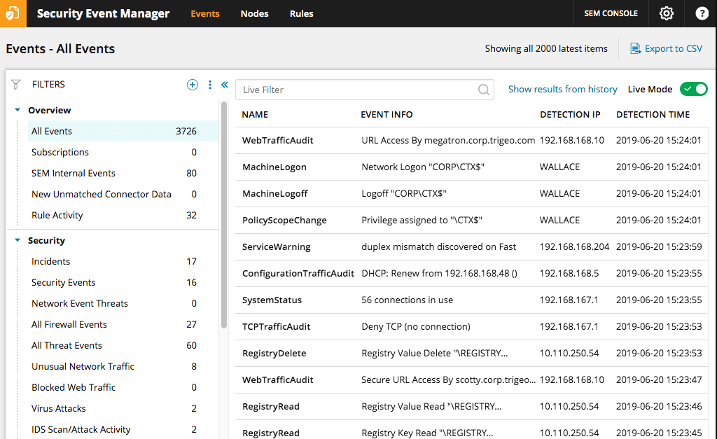
Continue..

